Slide 1

Coding Challenge
Team 7

Slide 2
Design Philosophy
Low overshoot
Avoid collisions
Adhere to velocity limitations
Flexible control parameters that can be tuned for any situation
Can approach each challenge differently with minor modifications
Velocity capping mechanism
Intricate PID Control with extra Damping Feedback

Slide 3
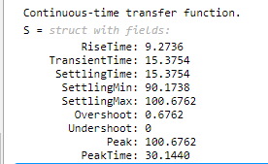
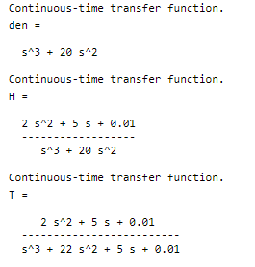
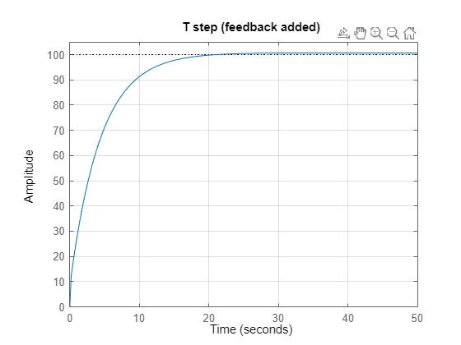
Control Design - Matlab

Slide 4

Code Overview

Slide 5
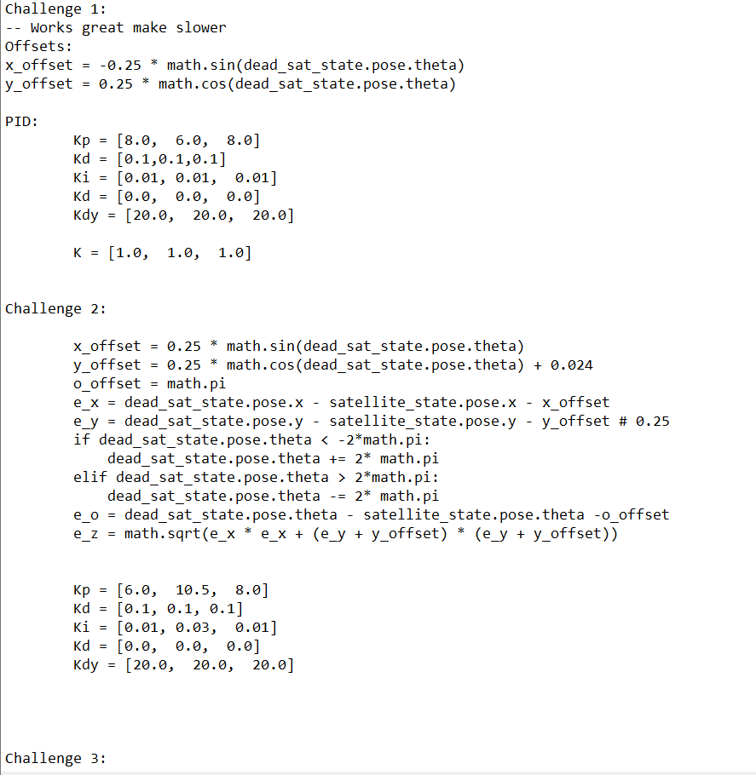
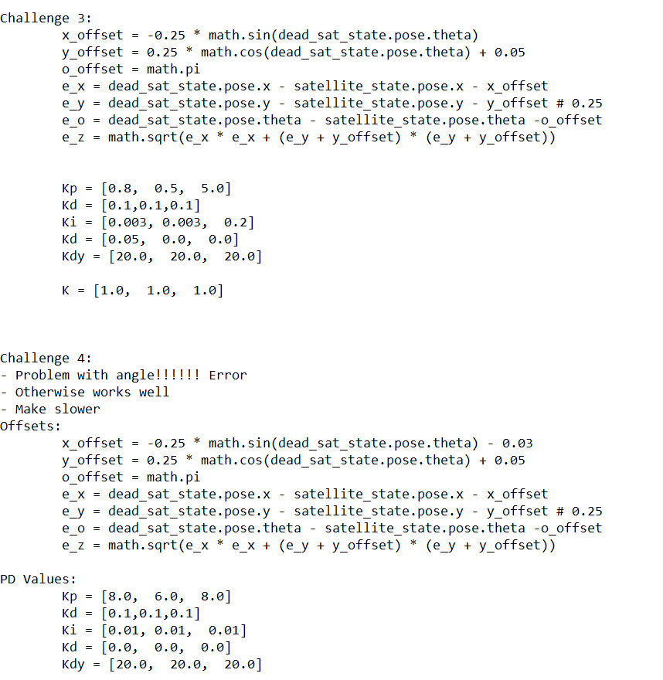
Challenge Specific Parameters

Slide 6
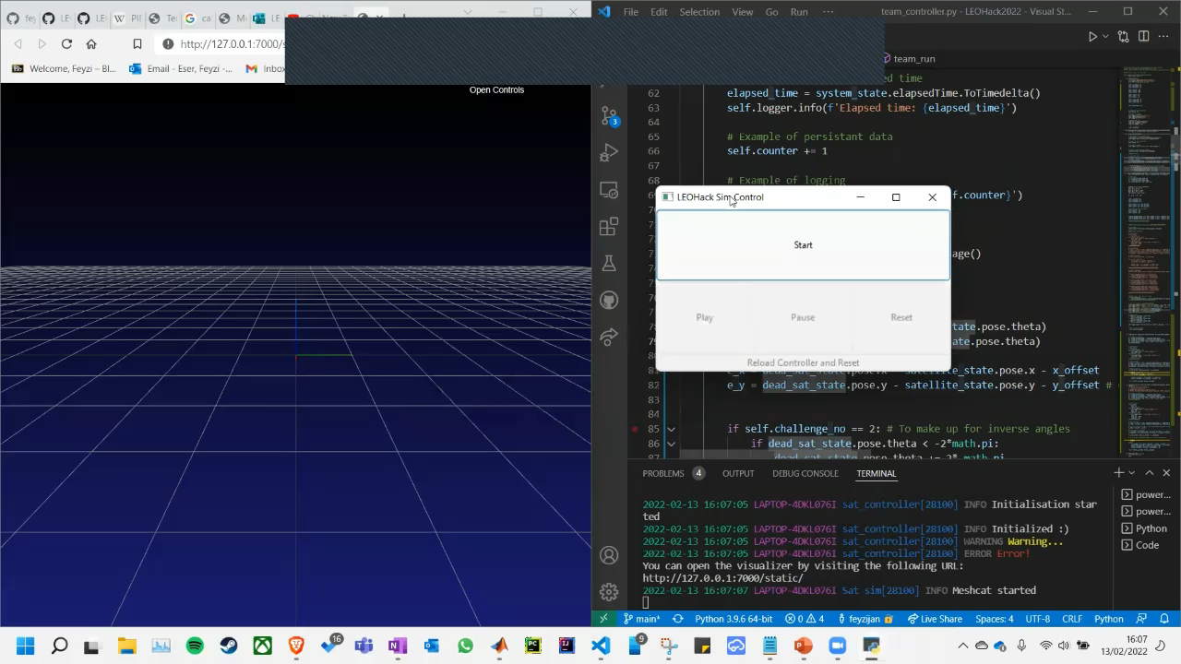
Challenge 1

Slide 7
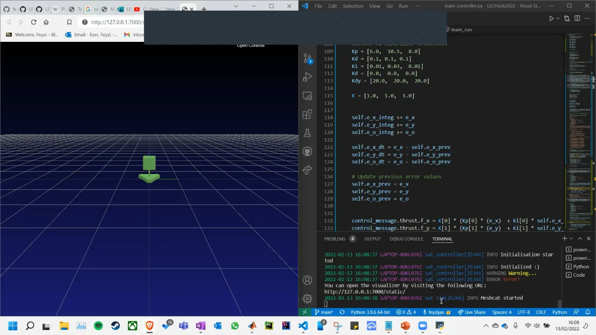
Challenge 2

Slide 8
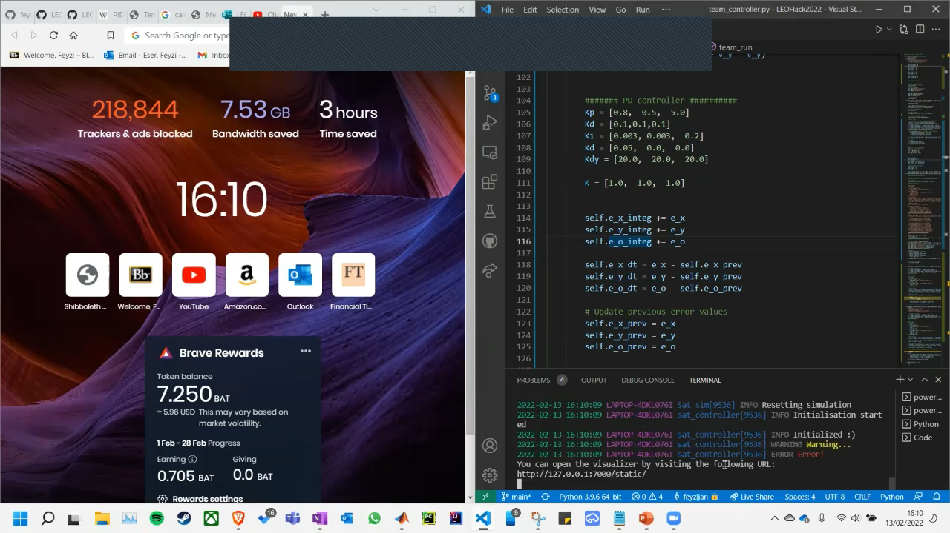
Challenge 3

Slide 9
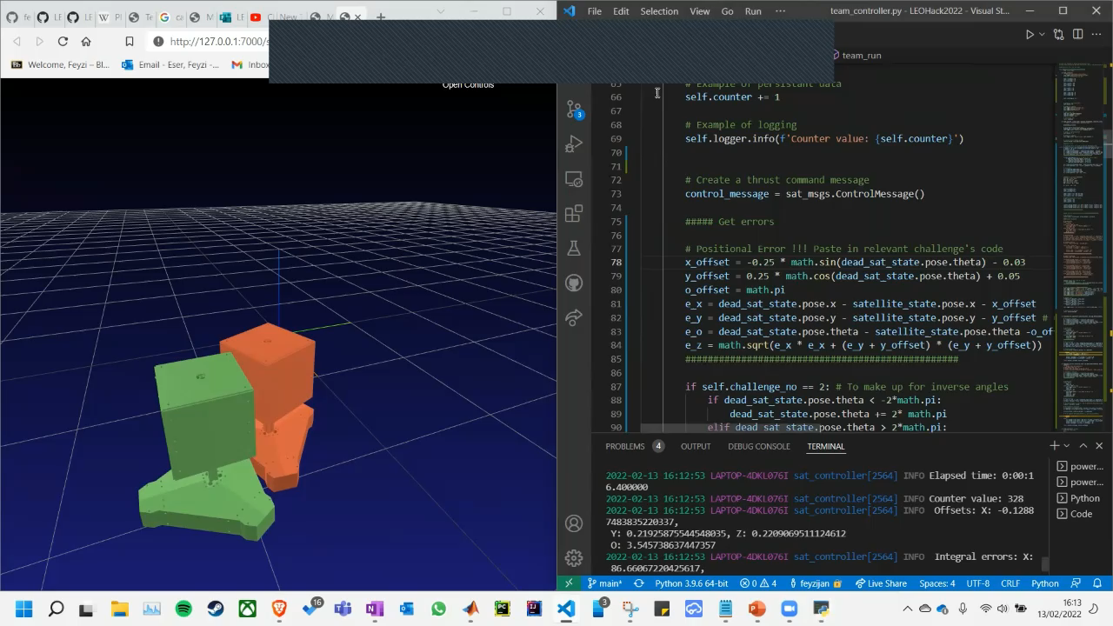
Challenge 4

